Slide 1
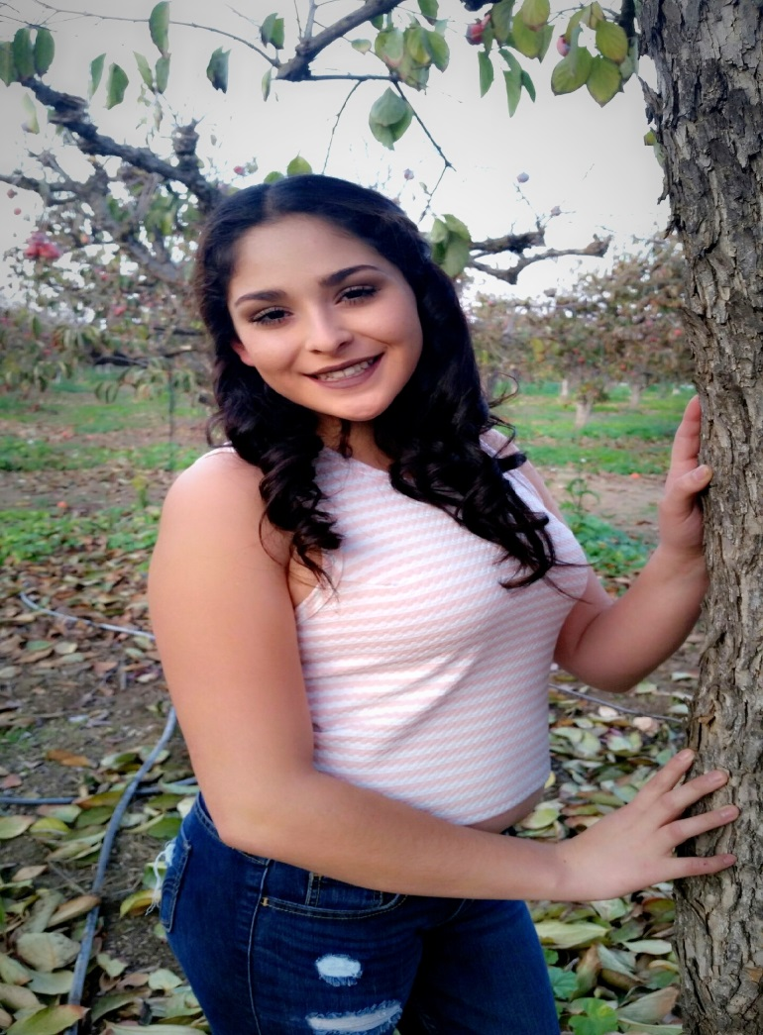
Edith andrade ceballos

Slide 2
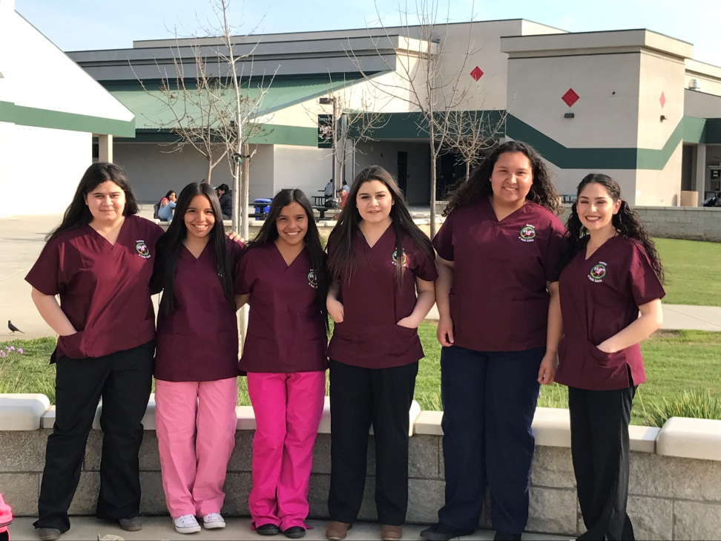
About Me
I live with both my parents and with my 3 sisters and 1 brother.
I’m interested in becoming a Registered Nurse.
A challenge I faced was deciding between two pathways
- Registered Nurse
- Teacher

Slide 3
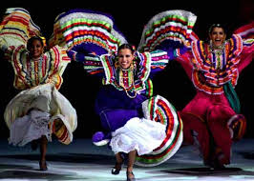
High School Experience
Clubs I joined were Yearbook, My Voice , Art Club, and Ballet Folklorico
The PBS helps out a lot by the way it uses it’s teaching performance.
My personal challenge would be staying focus
What I learned was that I am a smart girl but I just need to put effort on my work to get it done
High School prepared me for college it taught me what to do and what not to do.

Slide 4
Job Shadow
For my job shadow I picked a teacher because teaching catches my attention
It connects because at one point in my life, I wanted to become an elementary teacher
What I thought was interesting was the way teachers teach. Every teacher teaches their own way.
Memorable moment for me would be that being a teacher is a model and is leading students to a good path
Yes I do see me working as a teacher at some point in life. I really like the way teachers teach and care about they’re students

Slide 5
Pathway
My pathway is Spanish
It relates because to work in a nurse career you would need to know Spanish and English or at any job
I already know Spanish but it taught me the correct way to write, say, and spell words in Spanish

Slide 6
Post-High School Plans
I’m going to College of the Sequoias in Visalia for 2 years and transfer to Fresno state
I applied to COS and Fresno State. I got accepted to both COS and Fresno State.
It fits me because by going somewhere close to home can prepare me when I leave somewhere far to study.
I got help from FASFA
My goal is to complete everything and start working in my career

Slide 7
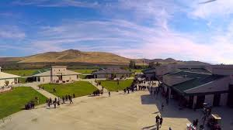
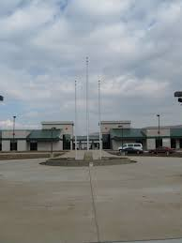
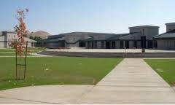
Leaving LHS
High school did shape me and helped me become more responsible. The teachers helped me a lot and got me to where I am.
The PBS helped with the ways the teachers taught me and they made me realize that school is important.

Slide 8
Thank you!

